Slide 1


Group RNA and DNA virus
Lecture 8
Prof. Dr. Munira Ch. Ismaeel
Ass. Prof. Dr. Israa AJ Ibrahim

Slide 2

Group RNA and DNA virus Lec. 8
Prof. Dr. Munira Ch. Ismaeel and Ass. Prof. Dr. Israa AJ Ibrahim

Slide 3
Viruses are grouped according to the type of nucleic acid into:
RNA Viruses
An RNA virus is a virus that has RNA (ribonucleic acid) as its genetic material. This nucleic acid is usually single-stranded RNA (ssRNA) but may be double-stranded RNA (dsRNA). Notable human diseases caused by RNA viruses include Ebola hemorrhoragic fever, SARS, the common cold, influenza, hepatitis C, West Nile fever, polio and measles.

Slide 4
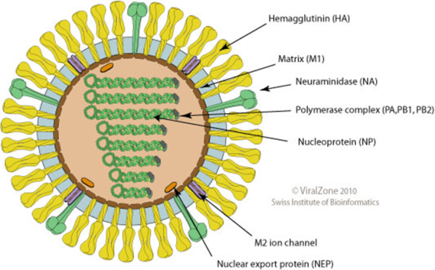
Orthomyxoviridae - Influenza Viruses
enveloped RNA viruses; protein spikes in envelope; its RNA is divided into 8 separate pieces, each one packaged in a helical capsid
Flu viruses; 3 types (A, B, C); A is the most common, infecting many species of animals, including humans; A is responsible for many pandemics (worldwide epidemics); B & C only infect humans & do not cause pandemics; Outbreaks of B occur every 2-3 years; C causes mild cold-like illnesses.

Slide 5
Influenza Viruses
The influenza virion (as the infectious particle is called) is roughly spherical. It is an enveloped virus – that is, the outer layer is a lipid membrane which is taken from the host cell in which the virus multiplies. Inserted into the lipid membrane are ‘spikes’, which are proteins – actually glycoproteins, because they consist of protein linked to sugars – known as HA (hemagglutinin) and NA (neuraminidase). These are the proteins that determine the subtype of influenza virus, for example: A/H1N1and H3N1 (swine flu).

Slide 6
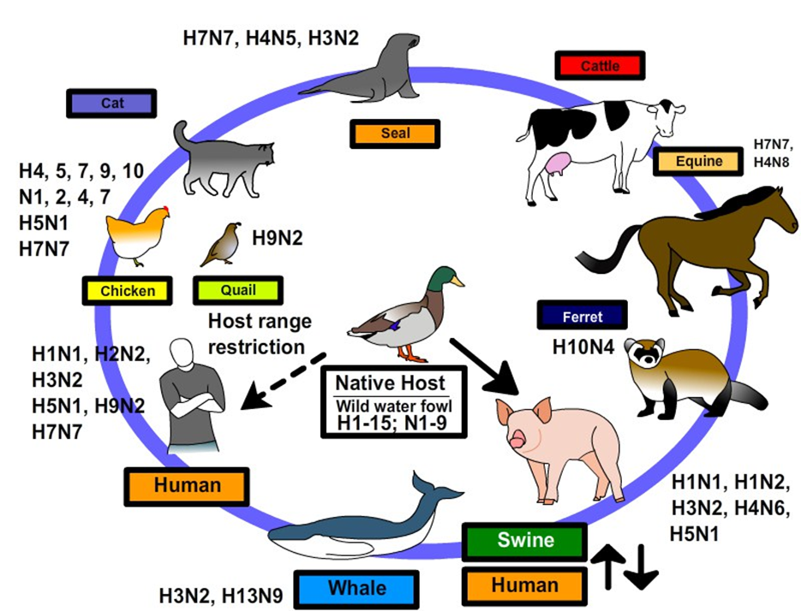
Influenza Viruses

Slide 7
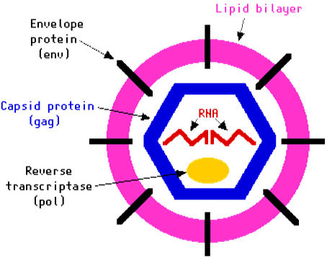
RNA viruses
Paramyxoviridae
-enveloped RNA viruses; helical capsid.
-includes viruses that cause Mumps, Measles, Viral pneumonia, Bronchitis
Rhabdoviridae
-enveloped RNA viruses; helical capsid.
- includes Rabies virus.
Retroviridae (Retroviruses)
-large group of RNA viruses; includes HIV (Human Immunodeficiency Virus) which causes AIDS (acquired immune deficiency syndrome); infects T cells (type of white blood cell).
-capsid contains 2 copies of the same RNA molecule (called a diploid virus); capsid also contains the enzyme reverse transcriptase.

Slide 8
DNA Viruses
is a virus that has DNA (ribonucleic acid) as its genetic material. DNA viruses are divided into: double-stranded DNA viruses (eg, Herpes simplex, poxviruses), single-stranded DNA viruses (eg, parvoviruses).

Slide 9
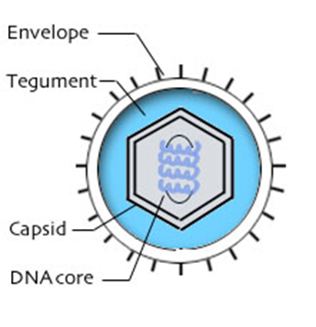
DNA Viruses
Herpesviridae - enveloped; polyhedral capsid; dsDNA
Simplex virus
-Herpes simplex 1 (oral lesions) and 2 (genital lesions)
-Tegument Between the capsid and envelope, consists of viral enzymes.

Slide 10
Viruses and Cancer
DNA and RNA viruses cause tumors in humans. Oncogenic viruses include hepatitis B (DNA), hepatitis C (RNA) — hepatocellular carcinoma, and papillomavirus (DNA) — cervical cancer. The Epstein-Barr virus (EBV), a DNA virus, is associated with the development of both lymphoid and epithelial tumors.

